Slide 1


PREDICTION OF CREDIT CARD APPROVAL
Presented By
P.HEMANTH | U.PURNIMA RAMANA | I.BHAVANI | P.SAI PRASANNA
Group 4 (M.Sc. Applied Statistics)
AURORA’S DEGREE & PG COLLEGE

Slide 2

2
ABSTRACT
To help streamline the application process and improve the approval rate by using machine learning models to predict credit card approval.
OBJECTIVE
In this project, we will explore how various factors affect credit card approval rates and use predictive models to improve the accuracy of credit card approval predictions.

Slide 3


3
CONTENT
4
INTRODUCTION
LITERATURE REVIEW
6
DATA DESCRIPTION
9
13
DATA PREPROCESSING
EXPLORATORY DATA ANALYSIS
16
MACHINE LEARNING ALGORITHMS
27
36
CONCLUSION
Kindly delete this note after editing this page. Thank you!
APPENDIX
39

Slide 4

4
INTRODUCTION
Credit cards are financial tools issued by banks that allow cardholders to borrow funds within a pre-approved limit to pay for goods and services.
The concept of credit cards is based on the idea of a revolving line of credit, which means that users can borrow money up to a certain limit, repay it, and borrow again as needed.
Key Features of Credit Cards
Borrowing Limit
Interest Rates
Building Credit History
Security Features

Slide 5

How Credit Cards Work
5
Purchasing Goods and Services:
When a cardholder makes a purchase, the bank pays the merchant on behalf of the cardholder. The cardholder then owes this amount to the bank, which they must repay by a specified due date.
Billing Cycle:
Credit cards operate on a monthly billing cycle. At the end of each cycle, the cardholder receives a statement detailing their purchases, the total amount owed, the minimum payment required, and the due date.
Repayment:
Cardholders can choose to pay the full balance, make the minimum payment, or pay any amount in between. Paying the full balance avoids interest charges, while paying less than the full amount leads to interest on the remaining balance.

Slide 6

LITERATURE REVIEW

Slide 7
7
David J. Hand and William E. Henley
Key Contribution
Hand and Henley (1997) are well-known for their work on statistical classification methods in credit scoring.
In their paper, they reviewed and compared traditional methods like logistic regression, discriminant analysis, and others, discussing their application in credit scoring and credit card approval processes.
They emphasized the importance of model accuracy and the trade-offs involved in choosing different statistical techniques.
Reference: Hand, D. J., & Henley, W. E. (1997). Statistical classification methods in consumer credit scoring: A review. Journal of the Royal Statistical Society: Series A (Statistics in Society), 160(3), 523-541.

Slide 8
8
Siddiqi Naeem
Key Contribution
Siddiqi contributed significantly to the field with his book Credit Risk Scorecards: Developing and Implementing Intelligent Credit Scoring.
He discussed the development of credit risk scorecards, which are widely used in the industry for credit card approval decisions. His work focuses on the practical aspects of implementing credit scoring models in financial institutions.
Reference: Siddiqi, N. (2012). Credit Risk Scorecards: Developing and Implementing Intelligent Credit
Scoring. John Wiley & Sons.

Slide 9

7
DATA DESCRIPTION

Slide 10

10
Dataset of Credit Card Approval is a secondary data.
It contains 690 rows and 16 Columns.
Categorical Variables
Numerical Variables
Gender
Married
BankCustomer
Industry
Ethnicity
PriorDefault
Employed
Driver’sLicense
Citizen
Approval status
Age
Debt
Years employed
Credit score
Income

Slide 11
11
Numerical Variables:
Age | Debt | Years Employed | Credit Score | Income
30.83 | 0.000 | 1.25 | 1 | 0
58.67 | 4.460 | 3.04 | 6 | 560
24.50 | 0.500 | 1.50 | 0 | 824
27.83 | 1.540 | 3.75 | 5 | 3
20.17 | 5.625 | 1.71 | 0 | 0
Source of the data:
UC IrvineMachine Learning 'Repository

Slide 12
12
Categorical Variables :
Gender
a-female
b-male
Married
u-married
y-single
l-divorce
Bank customer
g- have bank account
p-no bank account
gg- Inactive bank account
Industry
c- Energy
q- Materials
w-Industrials
i-ConsumerDiscretionary
aa-ConsumerStaples
ff-Healthcare
k-Financials
cc-InformationTechnology
m-CommunicationServices
x-Utilities
d-RealEstate
e-Education
j-Research
r-Energy
Ethnicity
v- white
h-black
bb-asian
ff-latino
j-others
z-others
dd-others
n-others
o-others
Prior default
t-yes
f-no
Employed
t-yes
f-no
Approval status
1-approved
0- denied
Drivers Licence
t-yes
f-no
Citizen
g-birth
s-other means
p-Temporary

Slide 13

10
DATA PREPROCESSING

Slide 14

14
Data Cleaning
Gender | Gender
Male | 468
Female | 210
? | 12
Gender | Gender
Male | 480
Female | 210
'?' marks replaced by mode
Married | Married
Married | 519
Single | 165
? | 6
Married | Married
Married | 525
Female | 165
'?' marks replaced by mode
BankCustomer, Industry, Ethnicity, Citizen
? marks values were also replaced by mode

Slide 15
15
Encoding Categorical Data
Categorical variables often need to be converted into a numerical format so that mathematical operations can be applied.
Dummy variables allow us to transform these categories into a form that can be easily used by the model.
Prior default | Prior default
t | 1
f | 0
Employee | Employee
t | 1
f | 0
Driver License | Driver License
t | 1
f | 0

Slide 16

13
EXPLORATORY DATA ANALYSIS

Slide 17
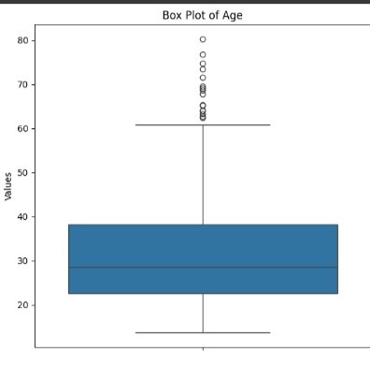
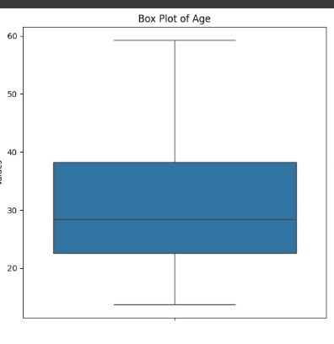
17
Box Plot
In EDA part we have used Box plot for outliers detection in Numerical data .
Approached Techniques for Handling outlier are:
Capping to percentile
Log transformation
Box plot for Age before Capping
Box plot for Age after Capping

Slide 18
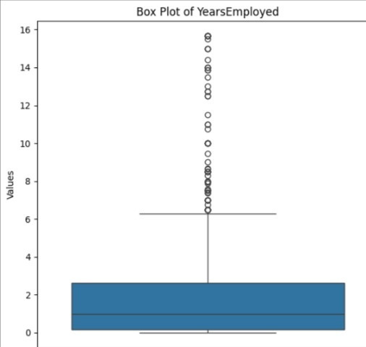
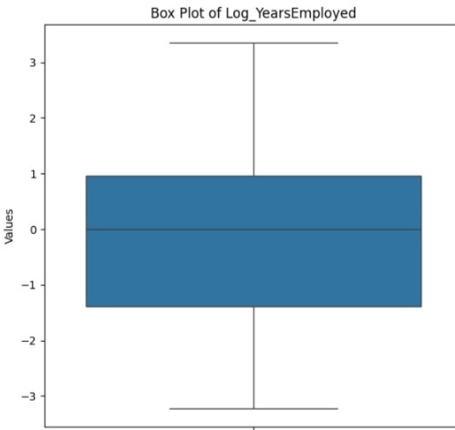
18
Log Transformation
Box plot for Years Employed before applying transformation
Box plot for Years Employed after applying log transformation
Outliers were identified and fixed

Slide 19

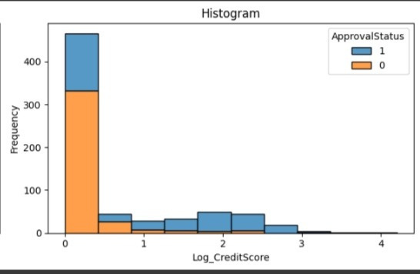
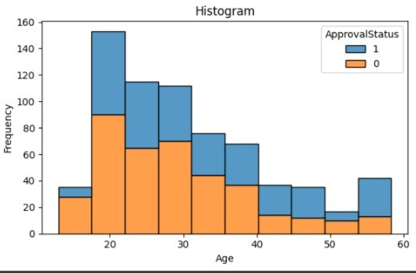
19
Histogram
For log of CreditScore , approval is more than denial
For age variable approval is more than denial
Histogram for log of credit score
Histogram for age
Notes:
A Histogram is a type of chart that shows the frequency distribution of data points across a continuous range of numerical values.

Slide 20
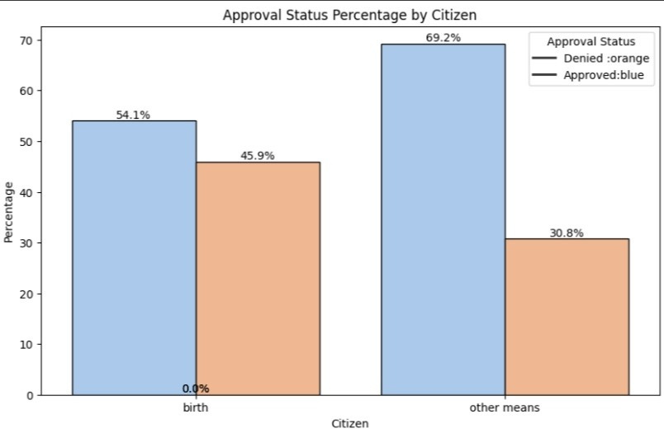
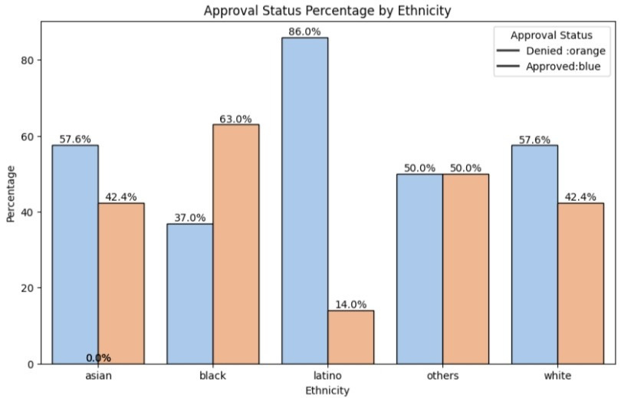
20
Bar Plot
Bar plot for Citizen
Bar plot for Ethnicity
For the both categories by birth and by others means the approval is more than denial.
More approvals for Asian customers vs More denial for Black customers
Notes:
For Categorical data, we used Bar plot for understanding the pattern for Approval Status.

Slide 21
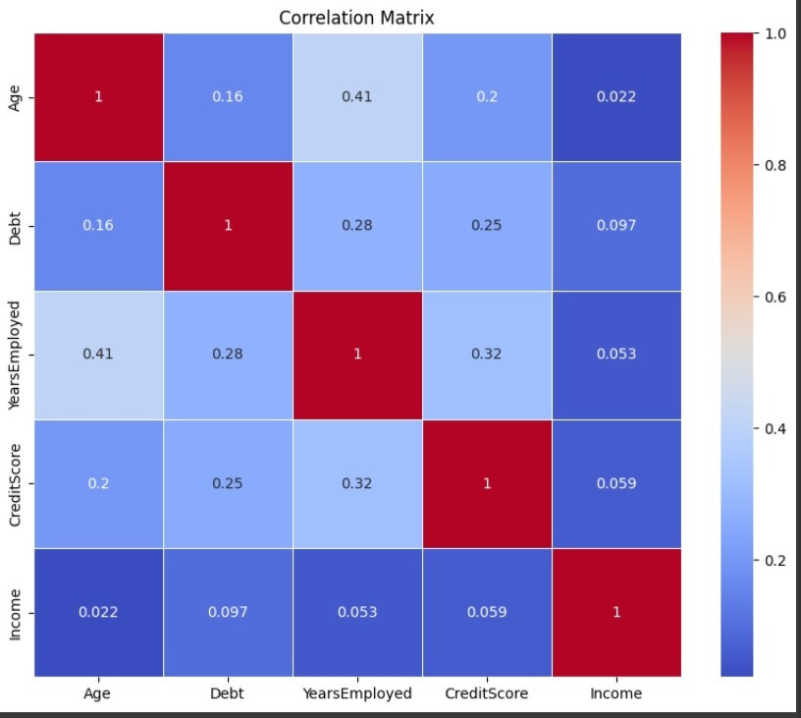
Correlation Matrix
21
Age and YearsEmployment have the highest correlation of 0.41, showing a moderate positive relationship.
Age and Income have the lowest correlation of 0.022, indicating minimal linear relationship.
Notes:
A correlation matrix is a statistical technique used to evaluate the relationship between two variables in a data set.

Slide 22
Data Reduction
22
For unnecessary data reduction ,we use the two features. They are
Multi Collinearity
For multi- collinearity check, we use variance inflation factor (VIF). It is a measure of the amount of multicollinearity in regression analysis. Multicollinearity exists when there is a correlation between multiple independent variables in a multiple regression model.
Feature Selection
The main goals of feature selection are to improve the model's performance, reduce overfitting, enhance generalization, and simplify the model by removing irrelevant or redundant features.

Slide 23
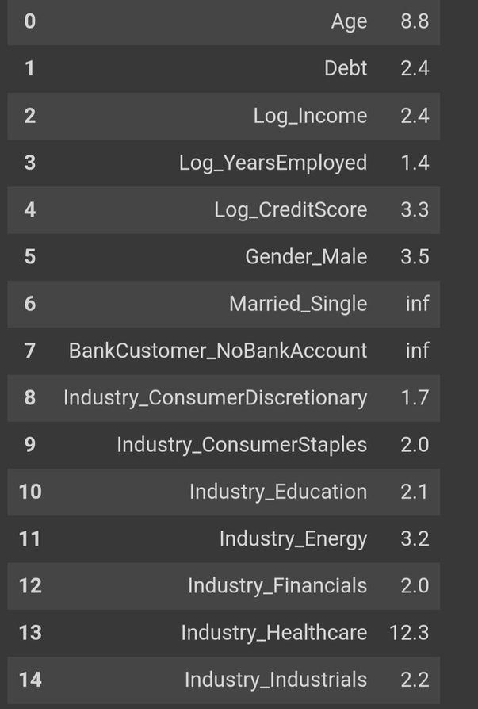
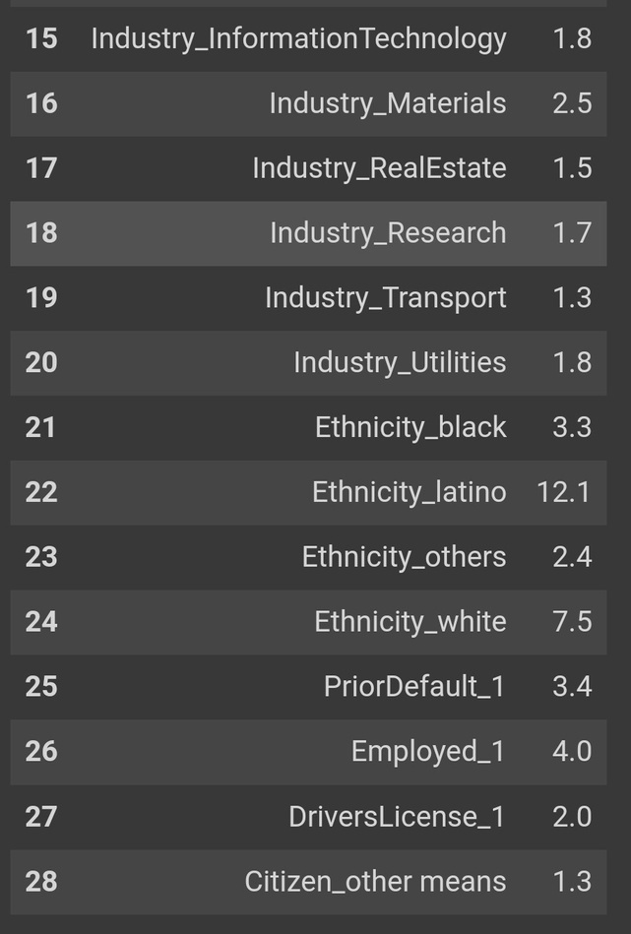
23
VIF values Before removing multicollinearity
Married_Single and BankCustomer_NoBankAccount have infinte VIF value
Industry_Healthcare and Ethnicity_latinoVIF value is greater than 10

Slide 24
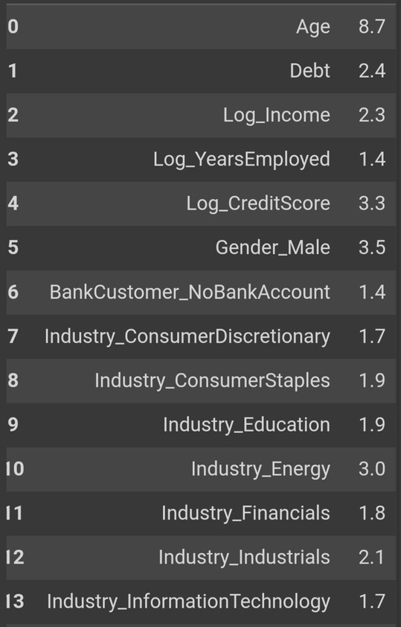
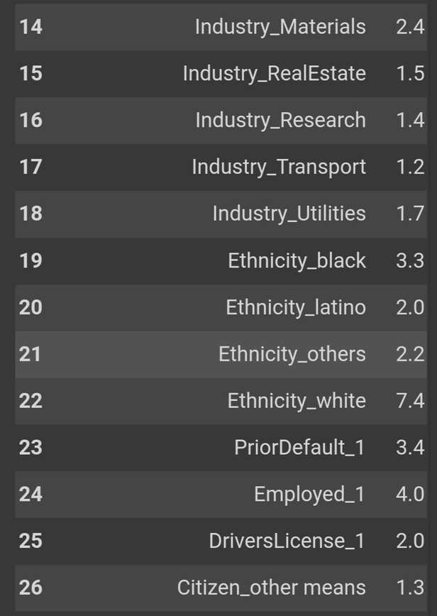
24
VIF values After removing multicollinearity
After removing the Married_Single Industry_Healthcare variables all the VIF values are under 10

Slide 25
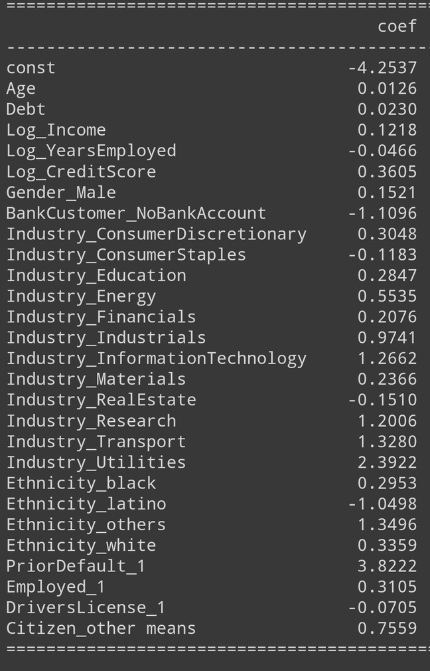
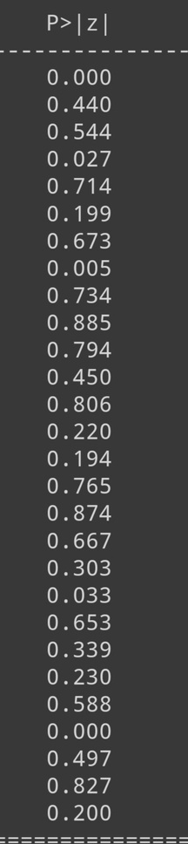
25
Feature Selection
Feature selection for significance testing involves selecting features based on their statistical significance, usually in the context of hypothesis testing.
"p ≤ 0.05: statistically significant;
p > 0.05: not statistically significant."

Slide 26
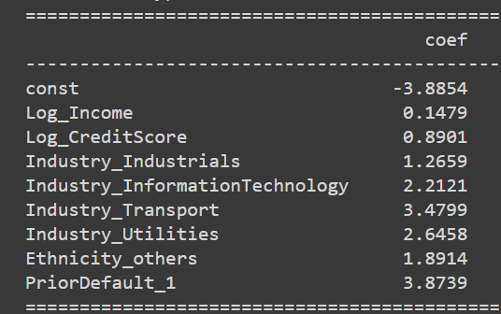
26
Feature Selection
The goal is to identify which features have a statistically significant relationship with the target variable, indicating that they might be important predictors in a model.
Below are the Significant features identified through feature selection.

Slide 27

24
MACHINE LEARNING ALGORTHIM

Slide 28
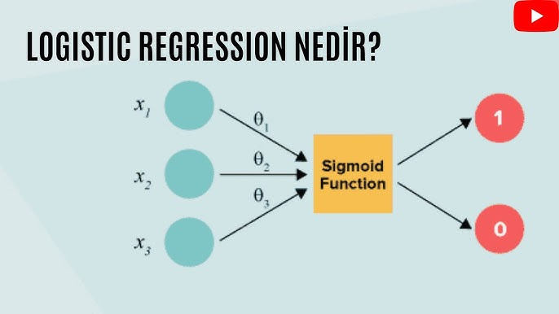
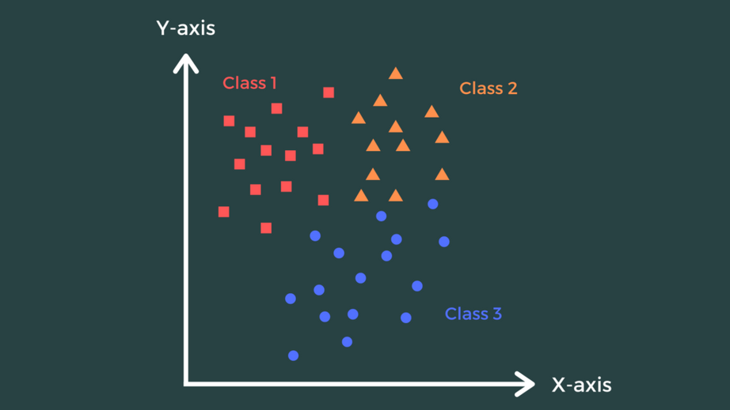
28
Logistic Regression
KNN
A statistical model used for binary classification that predicts the probability of a categorical outcome based on one or more predictor variables.
A classification algorithm that assigns labels based on the majority vote of nearest neighbors in the feature space.

Slide 29
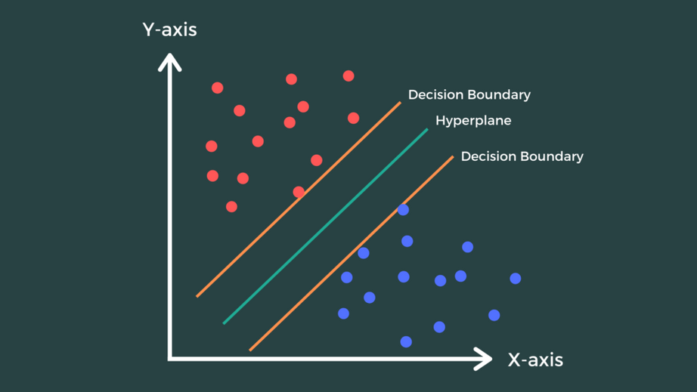
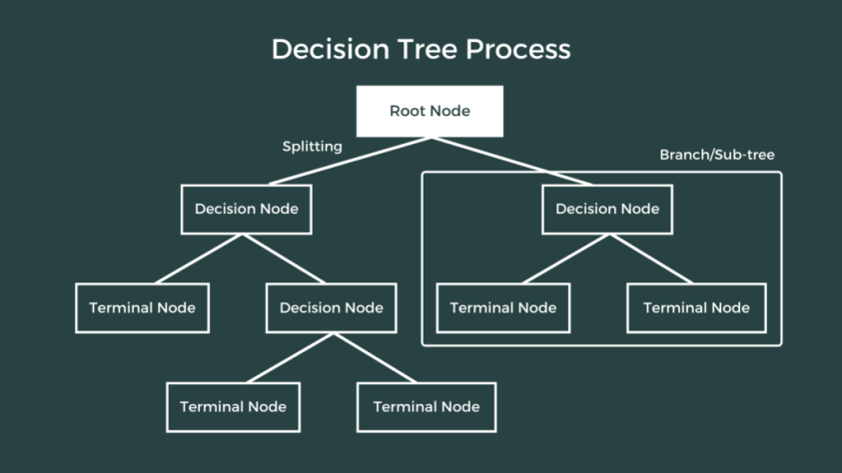
29
SVM
Decision Tree
A classification algorithm that finds the optimal hyperplane to separate data into distinct classes.
A model that splits data into subsets based on feature values to make predictions or decisions.

Slide 30
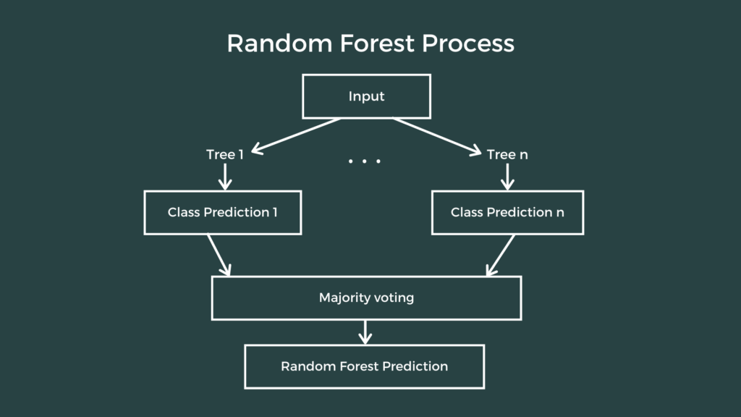
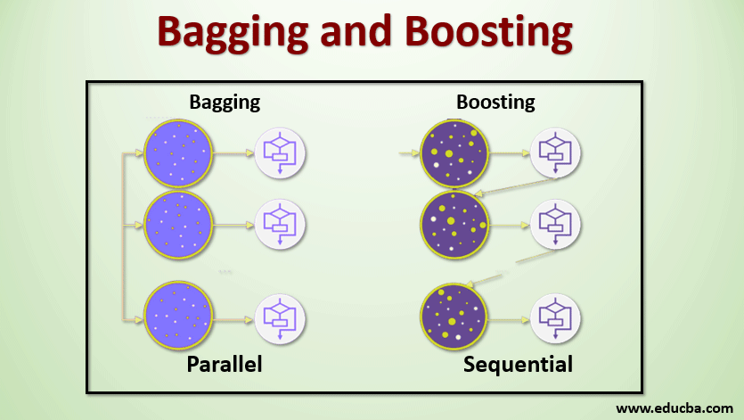
30
Random Forest
Bagging
Aggregates predictions from multiple models to improve accuracy and reduce variance
Boosting
Sequentially builds models to correct errors of previous ones, enhancing predictive performance.
An ensemble learning method that builds multiple decision trees and aggregates their predictions for improved accuracy and robustness..

Slide 31
31
80-20 Train-Test Split
Machine Learning Models | All Data | Data with No Multicollinearity Features | Data with Significant Features
Logistic Regression | 0.841 | 0.841 | 0.848
K-Nearest Neighbour | 0.783 | 0.783 | 0.812
Support Vector Machine | 0.826 | 0.826 | 0.841
Decision Tree | 0.768 | 0.768 | 0.804
Random Forest | 0.841 | 0.841 | 0.819
Bagging | 0.797 | 0.797 | 0.826
Boosting | 0.761 | 0.761 | 0.797
Notes:
Logistic Regression gave the highest accuracy with the dataset containing significant features

Slide 32
75-25 Train-Test Split
32
Machine Learning Models | All Data | Data with No Mullticolinearity Features | Data with Significance Features
Logistic Regression | 0.844 | 0.844 | 0.861
K-Nearest Neighbour | 0.798 | 0.798 | 0.821
Support Vector Machine | 0.832 | 0.832 | 0.855
Decision Tree | 0.775 | 0.775 | 0.827
Random Forest | 0.844 | 0.844 | 0.844
Bagging | 0.855 | 0.855 | 0.838
Boosting | 0.786 | 0.786 | 0.809
Notes:
Logistic Regression achieves the highest accuracy with the dataset containing significant features.

Slide 33
70-30 Train-Test Split
33
Machine Learning Models | All Data | Data with No Multicollinearity Features | Data with Significant Features
Logistic Regression | 0.841 | 0.841 | 0.855
K-Nearest Neighbour | 0.807 | 0.807 | 0.831
Support Vector Machine | 0.831 | 0.831 | 0.855
Decision Tree | 0.812 | 0.812 | 0.841
Random Forest | 0.86 | 0.86 | 0.841
Bagging | 0.865 | 0.865 | 0.845
Boosting | 0.812 | 0.812 | 0.836
Notes:
Bagging achieves the highest accuracy with the dataset containing All Data and Data with No Multicollinearity Features.

Slide 34
34
60-40 Train-Test Split
Machine Learning Models | All Data | Data with No Mullticolinearity Features | Data with Significant Features
Logistic Regression | 0.826 | 0.826 | 0.859
K-Nearest Neighbour | 0.808 | 0.808 | 0.859
Support Vector Machine | 0.855 | 0.855 | 0.859
Decision Tree | 0.801 | 0.801 | 0.859
Random Forest | 0.862 | 0.862 | 0.859
Bagging | 0.822 | 0.822 | 0.859
Boosting | 0.801 | 0.801 | 0.859
Notes:
Random Forest achieves the highest accuracy with the dataset containing All Data, Data with NoMulticolinearity Features and significant features.

Slide 35
35
Algorithms Comparison
Data | Over All Data |  |  |  | Data With No Multicolinearity Features |  |  |  | Data With Significant Features
ML Algorithms | 80-20 | 75-25 | 70-30 | 60-40 | 80-20 | 75-25 | 70-30 | 60-40 | 80-20 | 75-25 | 70-30 | 60-40
Logistic regression | 0.841 | 0.844 | 0.841 | 0.826 | 0.841 | 0.844 | 0.841 | 0.826 | 0.848 | 0.861 | 0.855 | 0.859
K-Nearest Neighbour | 0.783 | 0.798 | 0.807 | 0.808 | 0.783 | 0.798 | 0.807 | 0.808 | 0.812 | 0.821 | 0.831 | 0.859
Support vector machine | 0.826 | 0.832 | 0.831 | 0.855 | 0.826 | 0.832 | 0.831 | 0.855 | 0.841 | 0.855 | 0.855 | 0.859
Decision Tree | 0.768 | 0.775 | 0.812 | 0.801 | 0.768 | 0.775 | 0.812 | 0.801 | 0.804 | 0.827 | 0.841 | 0.859
Random Forest | 0.841 | 0.844 | 0.86 | 0.862 | 0.841 | 0.844 | 0.86 | 0.862 | 0.819 | 0.844 | 0.841 | 0.859
Bagging | 0.797 | 0.855 | 0.865 | 0.822 | 0.797 | 0.855 | 0.865 | 0.822 | 0.826 | 0.838 | 0.845 | 0.859
Boosting | 0.761 | 0.786 | 0.812 | 0.801 | 0.761 | 0.786 | 0.812 | 0.801 | 0.797 | 0.809 | 0.836 | 0.859
Overall Performance: The models generally show better performance with the "Data with Significant Features" and "Data with No Multicollinearity Features" compared to "All Data."

Slide 36

33
CONCLUSION

Slide 37
37
Conclusion
Overall, for our credit card approval project, the Random Forest and Bagging models performed the best in most scenarios, making them strong candidates for deployment.
Logistic Regression also offers reliable results across all datasets and ratios. Selecting the appropriate model will depend on the specific data characteristics and performance requirements of the project.
The 60-40 split is results as the ‘Best Spilt’
The dataset with significant features maintains the highest accuracy compared to the other two datasets. Therefore, industries such as Transport, Utilities, and Information Technology have a higher likelihood of credit card approval.".

Slide 38

38
THANK YOU
P.Hemanth
U.Purnima Ramana
I.Bhavani
P.Sai Prasanna

Slide 39
APPENDIX

Slide 40
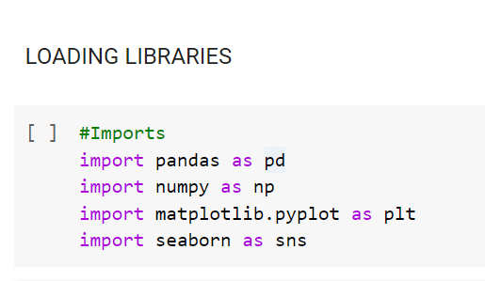
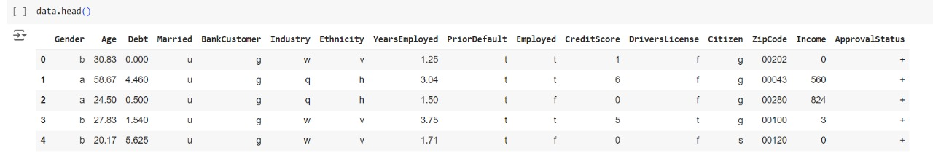
40

Slide 41
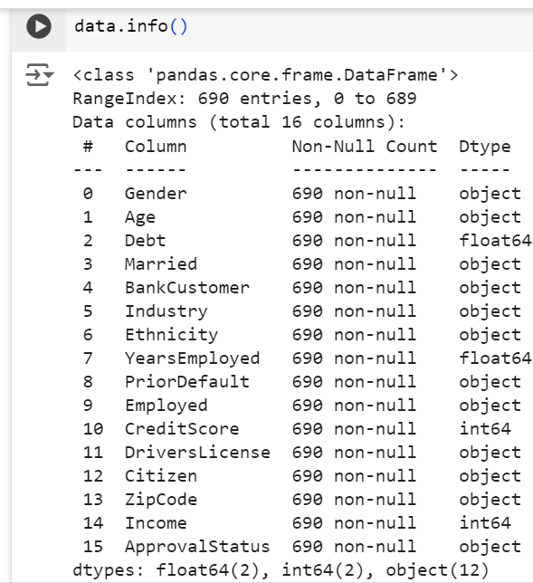
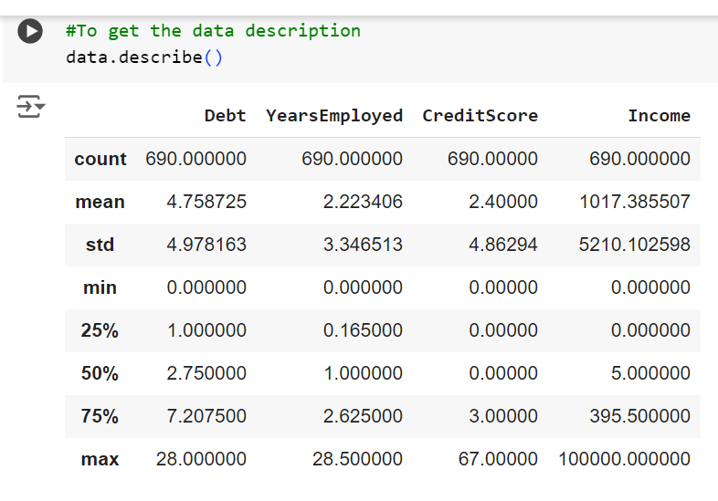
41

Slide 42
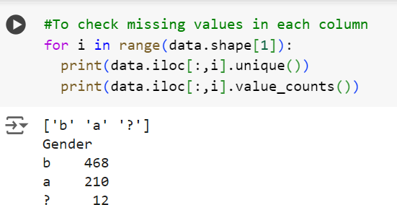
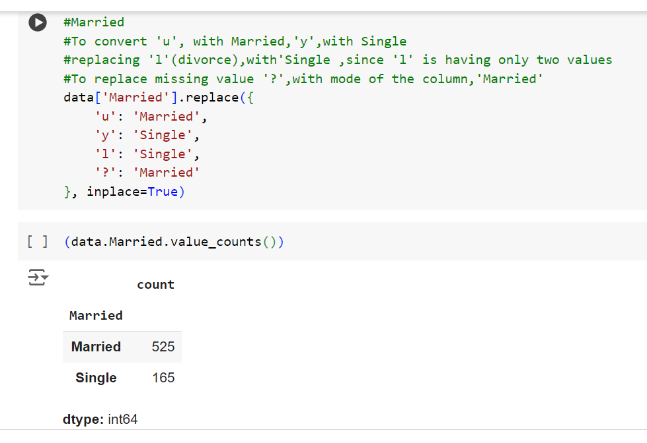
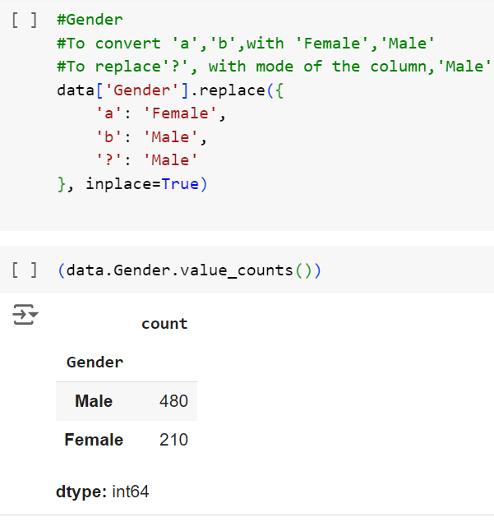
42

Slide 43
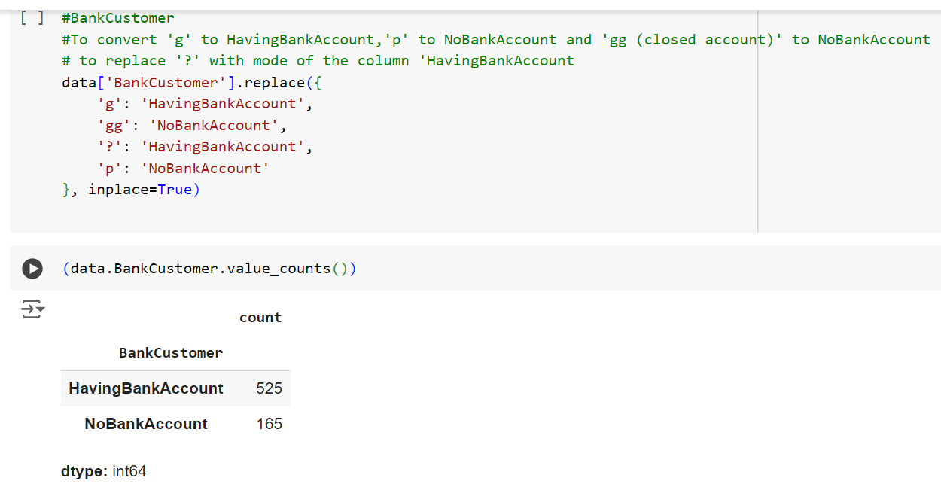
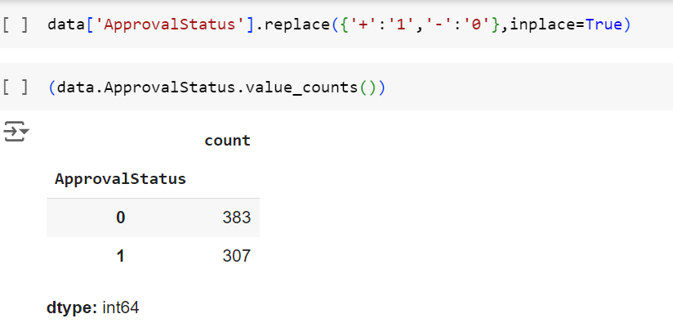
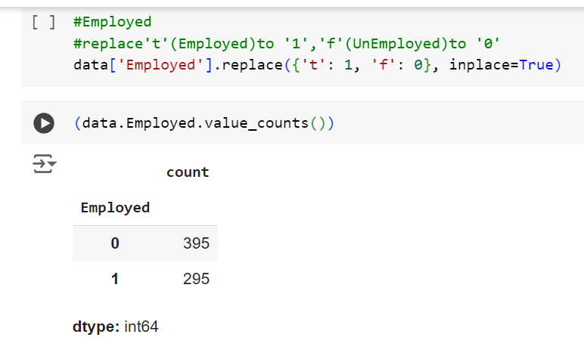
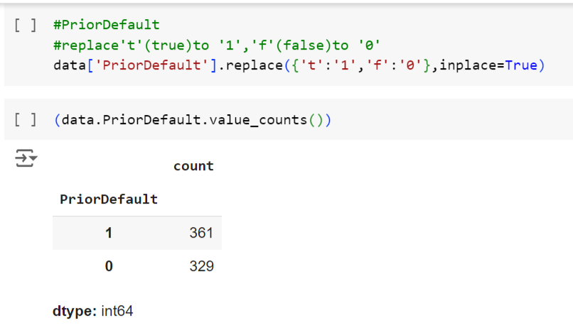
43

Slide 44
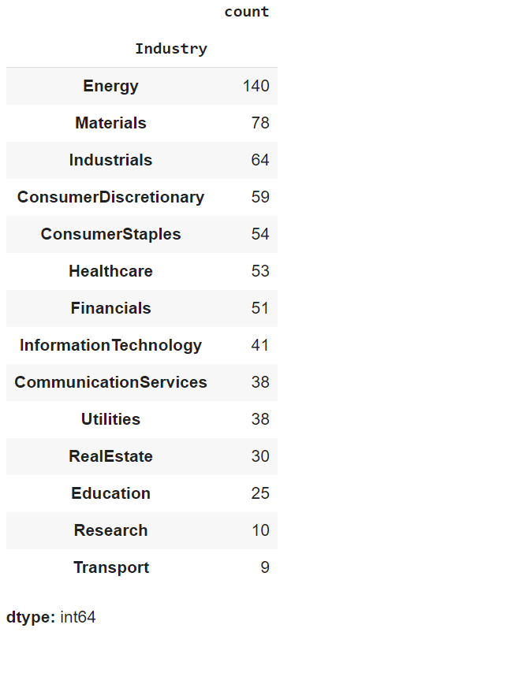
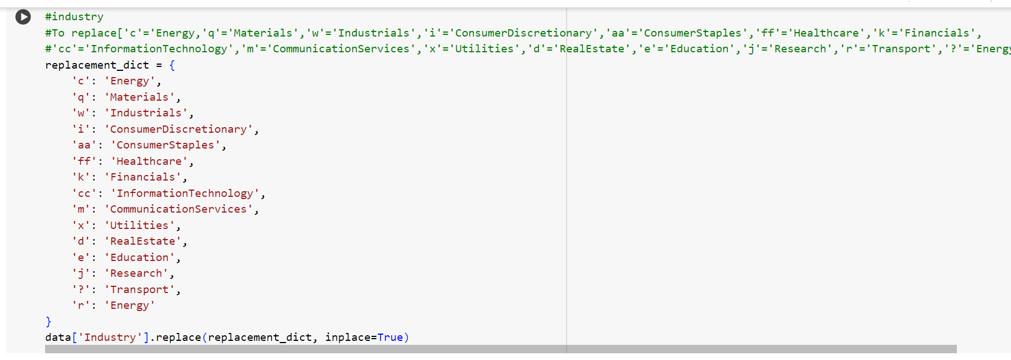
44

Slide 45
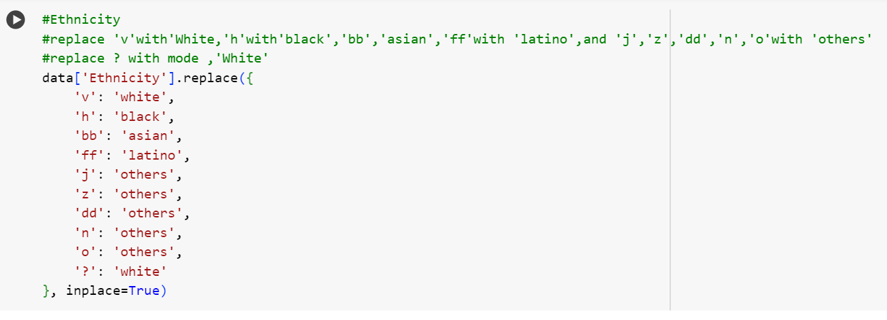
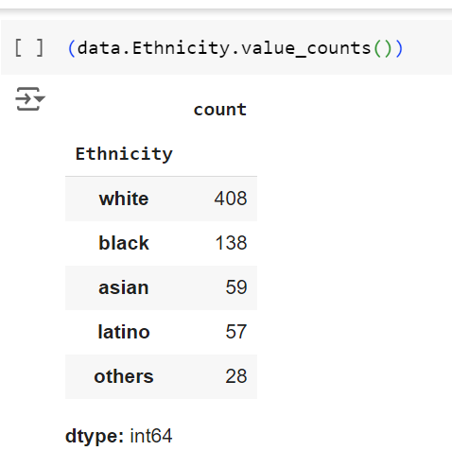
45

Slide 46
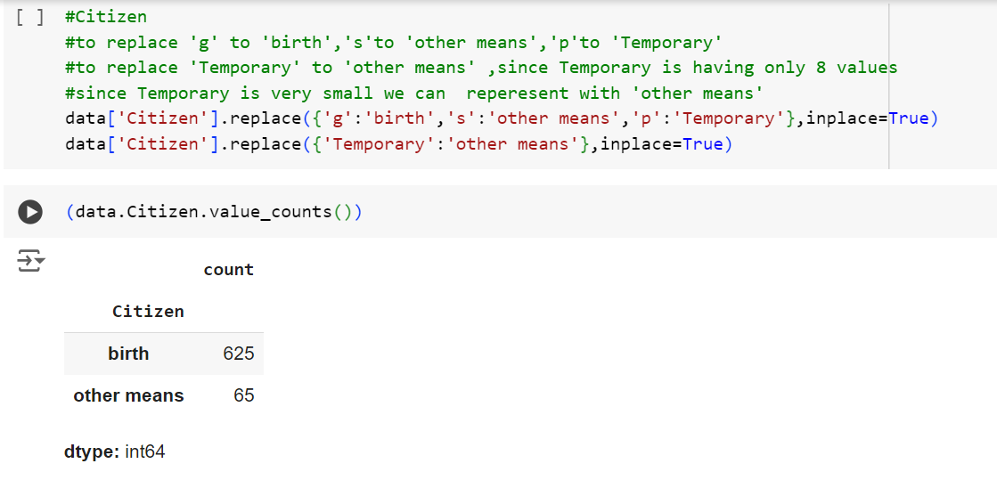
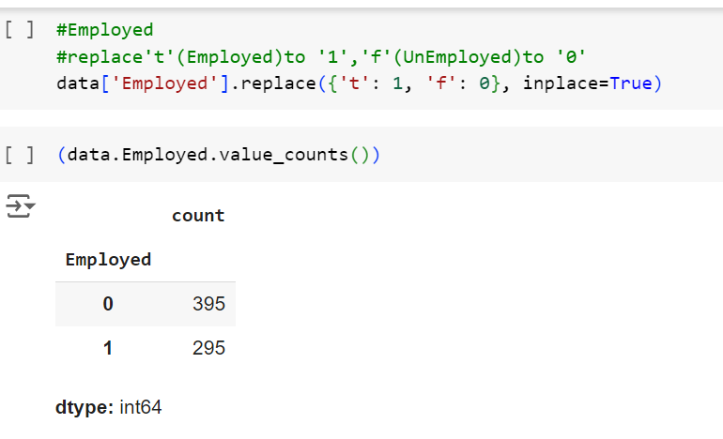
46

Slide 47
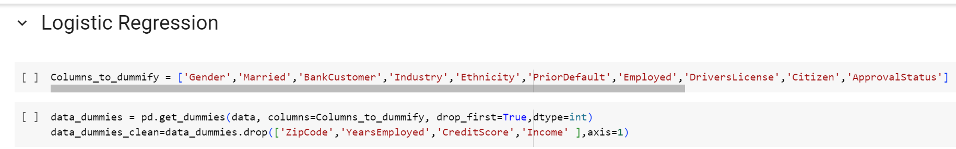
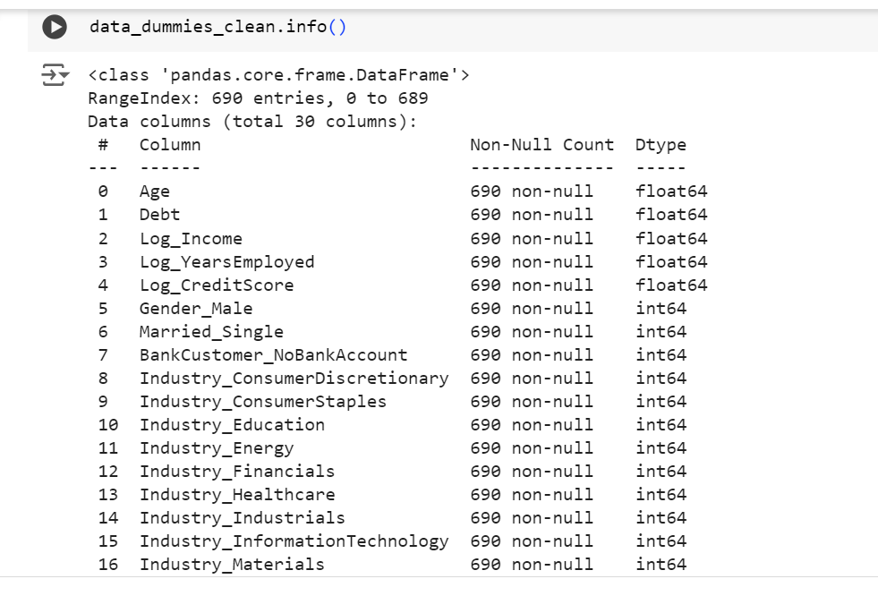
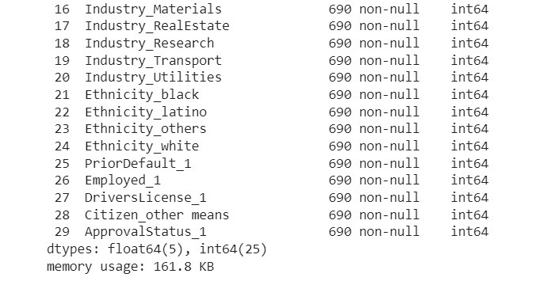
47

Slide 48
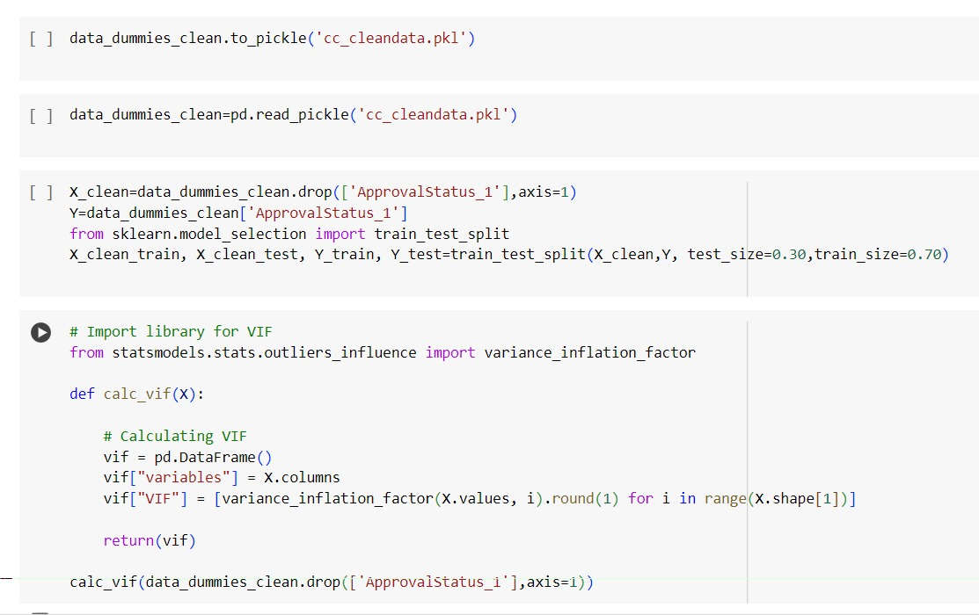
48

Slide 49
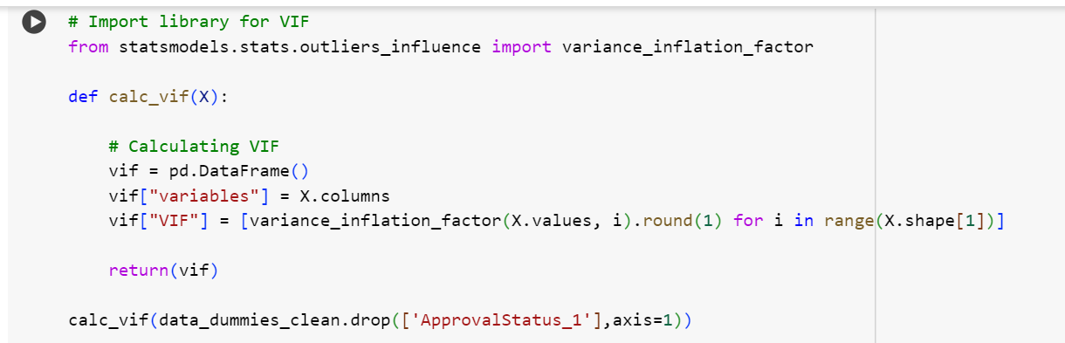
49

Slide 50
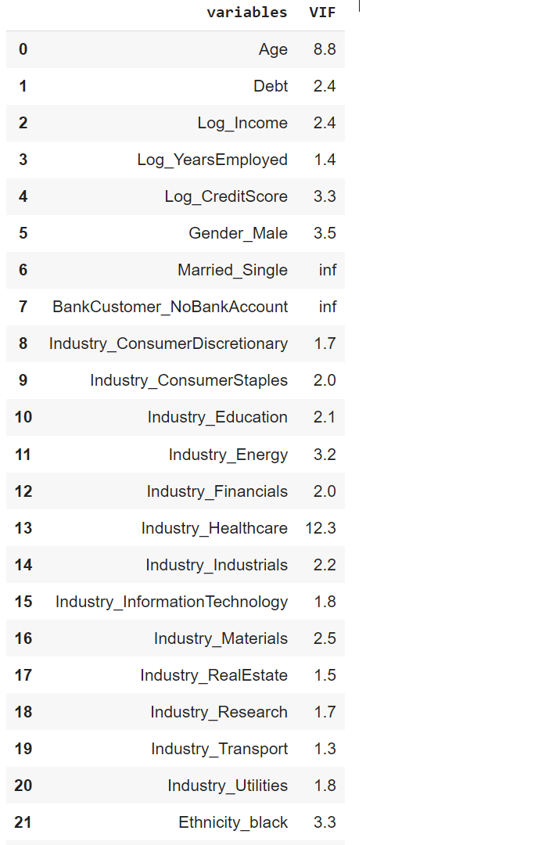
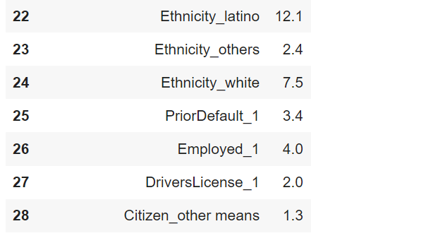
50

Slide 51
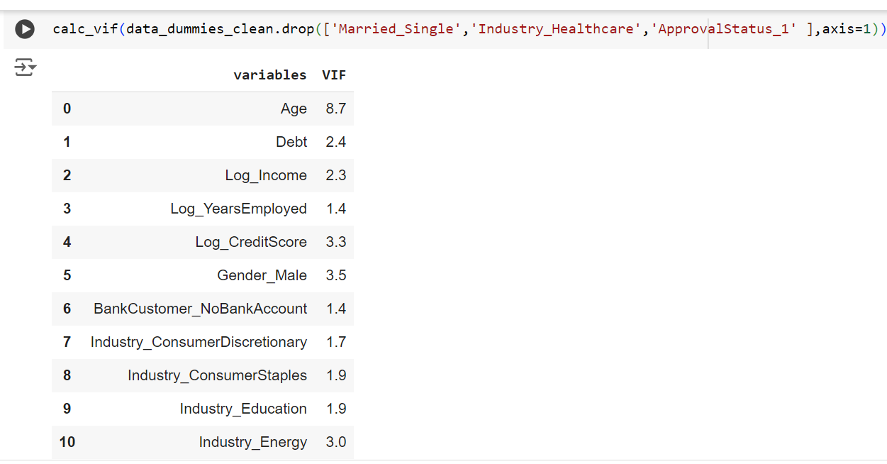
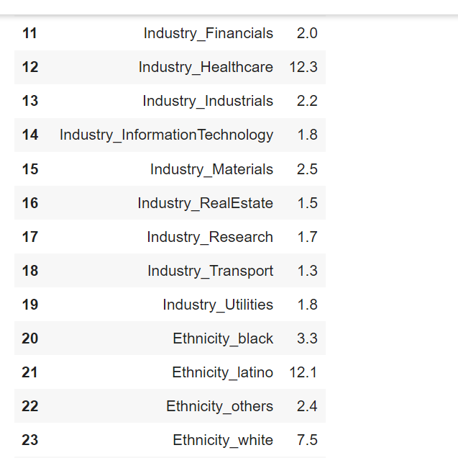
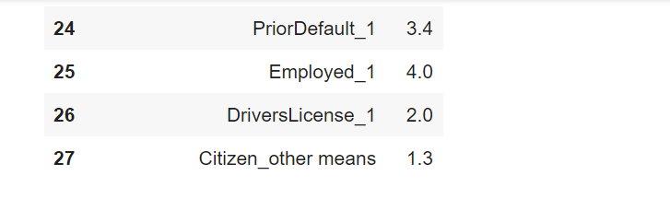
51

Slide 52
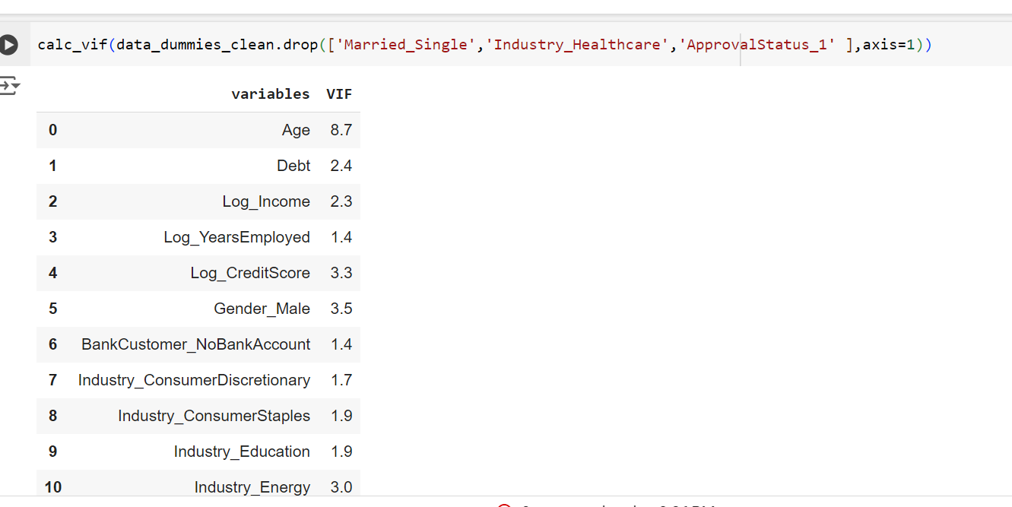


52

Slide 53


53

Slide 54

54

Slide 55

55

Slide 56

56

Slide 57


57

Slide 58


58

Slide 59


59

Slide 60


60

Slide 61


61

Slide 62


62

Slide 63


63

Slide 64

64

Slide 65


65

Slide 66


66

Slide 67



67

Slide 68


68

Slide 69



69

Slide 70

70

